Slide 1
Lab Session-III(a)
(Based on Logistic Regression)
Dr. Jasmeet singh
Assistant Professor, CSED
TIET, Patiala

Slide 2
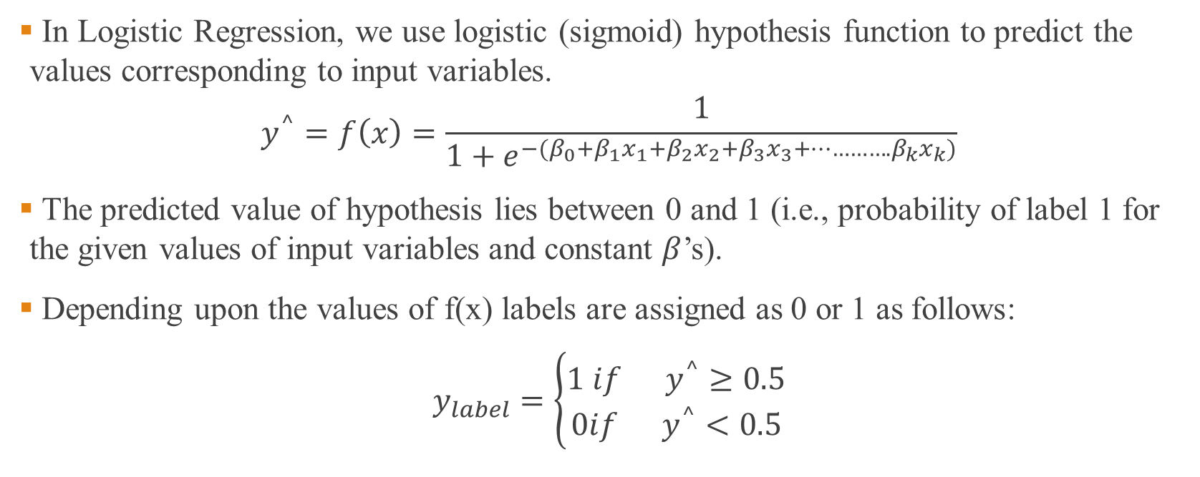
Introduction- Logistic Regression
In Logistic Regression, we use logistic (sigmoid) hypothesis function to predict the values corresponding to input variables.
$$y^{^}=f\left(x\right)=\frac{1}{1+e^{−(β_{0}+β_{1}x_{1}+β_{2}x_{2}+β_{3}x_{3}+………….β_{k}x_{k})}}$$
The predicted value of hypothesis lies between 0 and 1 (i.e., probability of label 1 for the given values of input variables and constant $β$’s).
Depending upon the values of f(x) labels are assigned as 0 or 1 as follows:
$y_{label}=\left\{\begin{aligned}1 if{ y}^{^}≥0.5 \\ 0if{ y}^{^}<0.5\end{aligned}\right.$

Slide 3
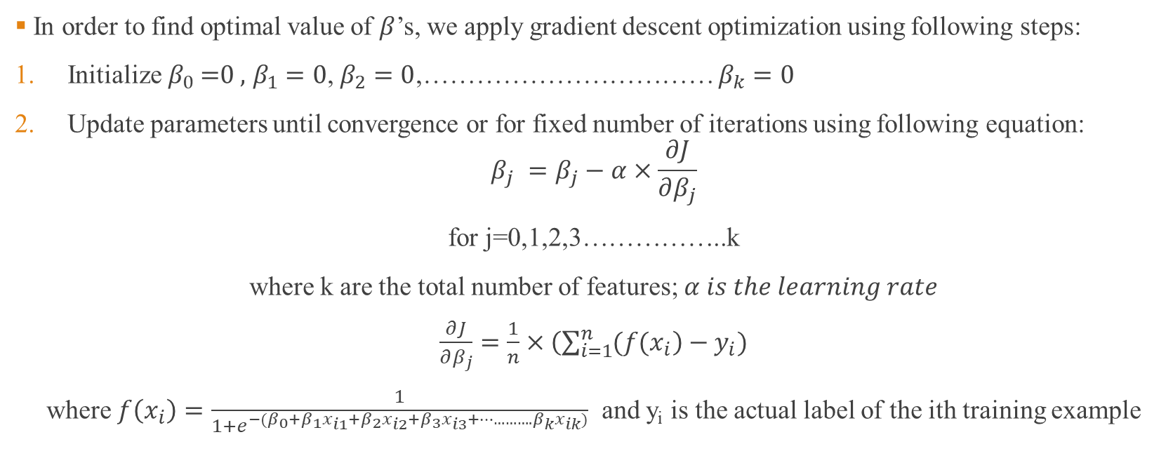

How to find optimal values of $β$’s ?
In order to find optimal value of $β$’s, we apply gradient descent optimization using following steps:
Initialize $β_{0}\text{ =0 }\text{,} β_{1}=0$, $β_{2}=0$,…………………………… $β_{k}=0$
Update parameters until convergence or for fixed number of iterations using following equation:
$$β_{j} =β_{j}−α×\frac{∂J}{∂β_{j}}$$
for j=0,1,2,3……………..k
where k are the total number of features; $α is the learning rate$
$\frac{∂J}{∂β_{j}}=\frac{1}{n}×\left(\sum_{i=1}^{n}{(f(x_{i}}\right)−y_{i})$
where $f\left(x_{i}\right)=\frac{1}{1+e^{−(β_{0}+β_{1}x_{i1}+β_{2}x_{i2}+β_{3}x_{i3}+………….β_{k}x_{ik})}}$ and y_{i} is the actual label of the ith training example

Slide 4
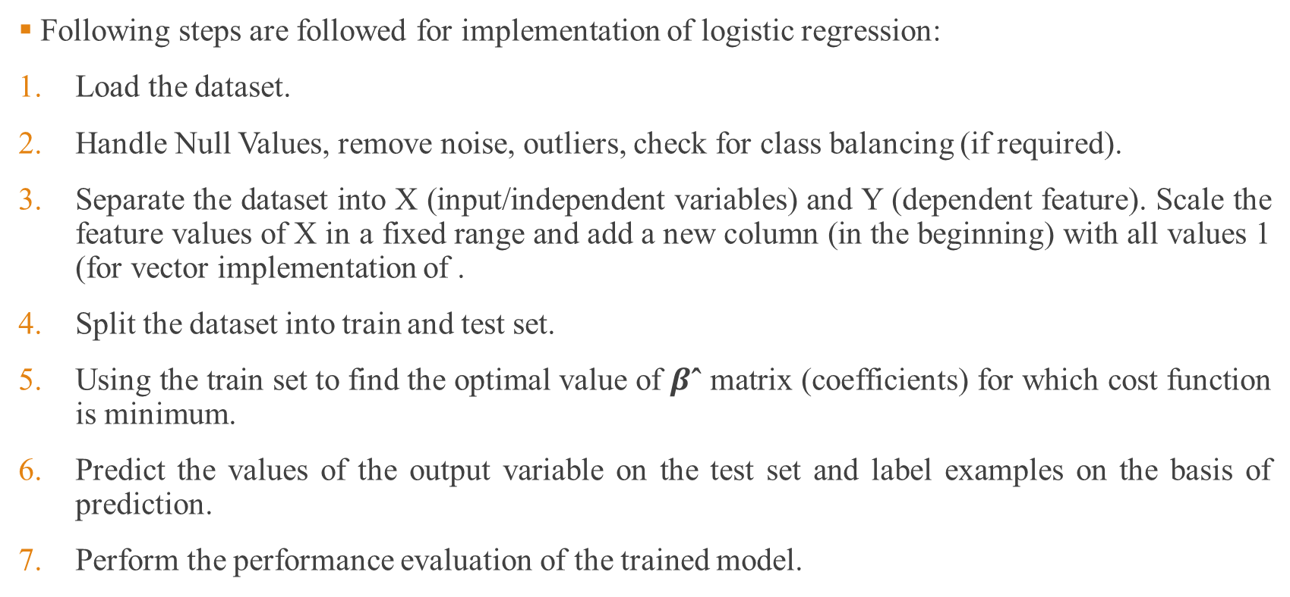
Implementation Logistic Regression
(Step-by-Step)
Following steps are followed for implementation of logistic regression:
Load the dataset.
Handle Null Values, remove noise, outliers, check for class balancing (if required).
Separate the dataset into X (input/independent variables) and Y (dependent feature). Scale the feature values of X in a fixed range and add a new column (in the beginning) with all values 1 (for vector implementation of .
Split the dataset into train and test set.
Using the train set to find the optimal value of $β\text{ˆ}$ matrix (coefficients) for which cost function is minimum.
Predict the values of the output variable on the test set and label examples on the basis of prediction.
Perform the performance evaluation of the trained model.

Slide 5
Step 1 (Logistic Regression): Load the Dataset
For implementation of Logistic Regression we will use heart attack labeling dataset downloadable from the following link:
https://drive.google.com/file/d/1hj_5K51WKKcOscHrjteXuWFu87Coe8XG/view?usp=sharing
The dataset checks the presence of heart disease in the patient on the basis of age, sex, chest pain type, resting blood pressure, serum cholesterol, fasting blood sugar, electrocardiographic results, maximum heart rate, exercise induced angina, oldpeak, he slope of the peak, number of major vessels colored by flourosopy, thal: 3 = normal; 6 = fixed defect; 7 = reversable defect
Code:
import pandas as pd
df=pd.read_csv('C:/Users/jasme/Downloads/heart.csv')
df.info()

Slide 6
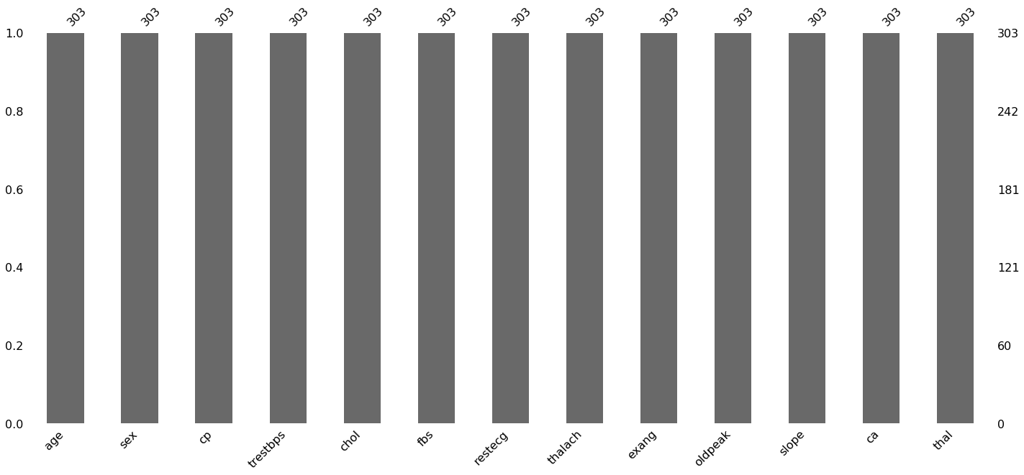
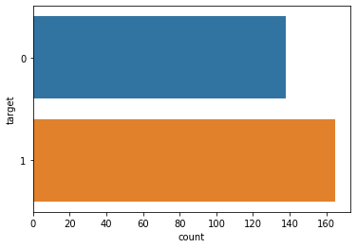
Step 2: Pre-processing
Checking for NULL values:
import missingno as msn
msn.bar(df.iloc[:,0:13])
There are no missing values in any input feature.
Checking for class balancing:
import seaborn as sns
sns.countplot(y=df.iloc[:,13],data=df)
Approximate number of samples are balanced; so no class balancing.

Slide 7
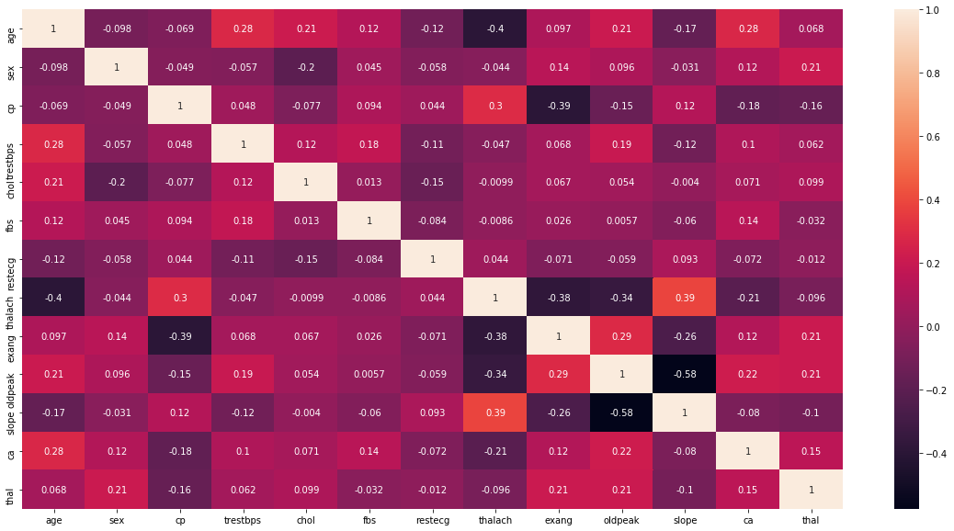
Step 2: Pre-processing (Contd…)
Checking for correlation between input features:
Code:
sns.heatmap(df.iloc[:,:13].corr(),annot=True)
As clear from the figure, the correlation values are quite less (less than 0.5)

Slide 8
Step 3: Splitting Input and Output features
Separate the dataset into X (input/independent variables) and Y (dependent feature).
Scale the feature values of X in a fixed range.
Add a new column (in the beginning) with all values 1.
Code:
from sklearn.preprocessing import StandardScaler
import numpy as np
X=df.iloc[:,0:13]
Y=df.iloc[:,13]
scaler=StandardScaler()
X_scaled=scaler.fit_transform(X)
X_scaled=np.insert(X_scaled,0,values=1,axis=1)

Slide 9
Step 4: Train/Test Split
We can split the train and test sets using train/test split of sklearn.model_selection as follows:
Code:
from sklearn.model_selection import train_test_split
X_train, X_test, Y_train, Y_test = train_test_split(X_scaled, Y, test_size=0.3, random_state=42)
Parameters:
test_size is the percentage of test set from the total dataset; random_state s used for initializing the internal random number generator, which will decide the splitting of data into train and test indices
If random_state is None or np.random, then a randomly-initialized RandomState object is returned.
If random_state is an integer, then it is used to seed a new RandomState object.

Slide 10
Step 5: Optimal β’s using Gradient Descent
Code:
n=1000 #number of iterations
alpha=0.01
m,k=X_train.shape
beta=np.zeros(k)
for i in range(n):
cost_gradient=np.zeros(k)
z=X_train.dot(beta)
predicted=1/(1+np.exp(-z))
difference=predicted-Y_train
for j in range(k):
cost_gradient[j]=np.sum(difference.dot(X_train[:,j]))
for j in range(k):
beta[j]=beta[j]-(alpha/m)*cost_gradient[j]
print(beta)

Slide 11
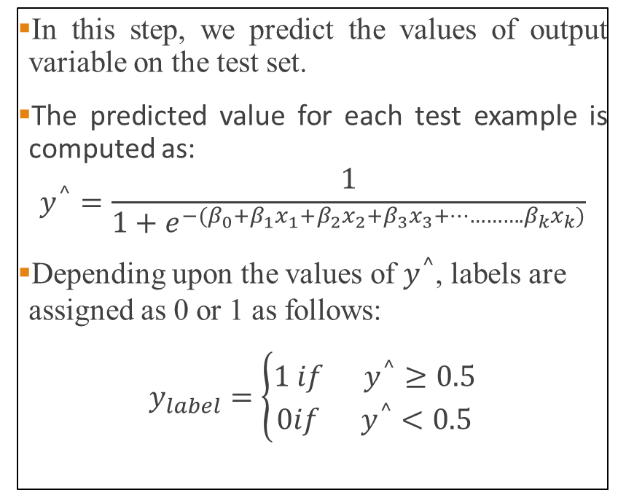
Step 6: Predicting and Labeling
In this step, we predict the values of output variable on the test set.
The predicted value for each test example is computed as:
$$y^{^}=\frac{1}{1+e^{−(β_{0}+β_{1}x_{1}+β_{2}x_{2}+β_{3}x_{3}+………….β_{k}x_{k})}}$$
Depending upon the values of $y^{^}$, labels are assigned as 0 or 1 as follows:
$y_{label}=\left\{\begin{aligned}1 if{ y}^{^}≥0.5 \\ 0if{ y}^{^}<0.5\end{aligned}\right.$
Code:
Y_predict=1/(1+np.exp(-(X_test.dot(beta))))
Y_label=np.zeros(len(Y_predict))
for i in range(len(Y_predict)):
if(Y_predict[i]>=0.5):
Y_label[i]=1

Slide 12
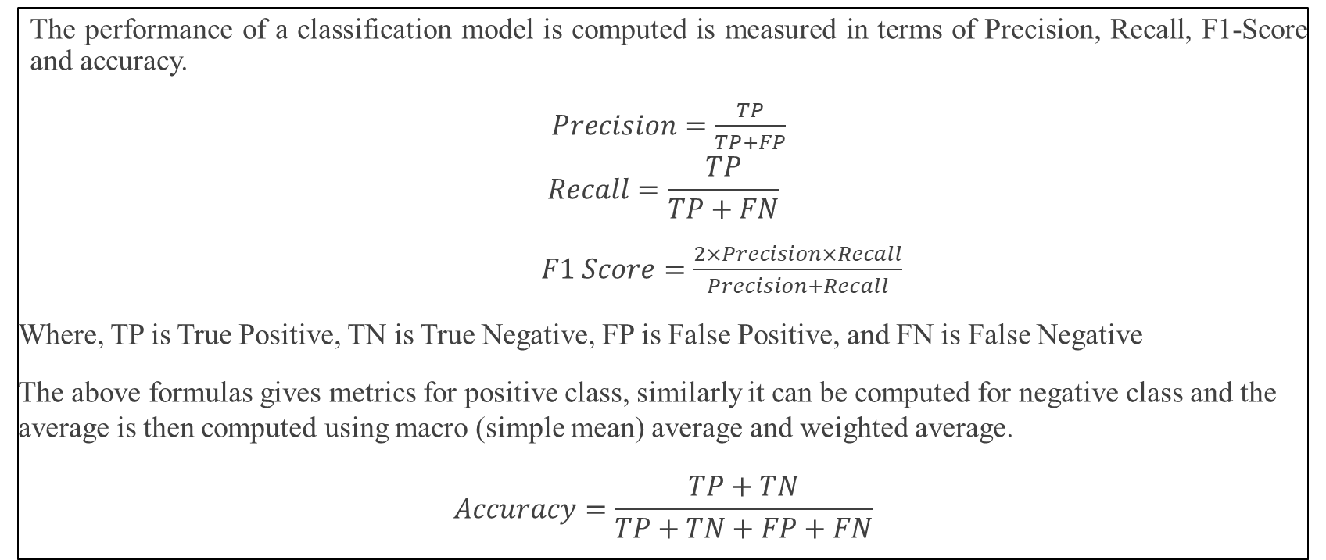
Step 7: Performance Evaluation
The performance of a classification model is computed is measured in terms of Precision, Recall, F1-Score and accuracy.
$Precision=\frac{TP}{TP+FP}$
$$Recall=\frac{TP}{TP+FN}$$
$F1 Score=\frac{2×Precision×Recall}{Precision+Recall}$
Where, TP is True Positive, TN is True Negative, FP is False Positive, and FN is False Negative
The above formulas gives metrics for positive class, similarly it can be computed for negative class and the average is then computed using macro (simple mean) average and weighted average.
$$Accuracy=\frac{TP+TN}{TP+TN+FP+FN}$$

Slide 13
Step 7: Performance Evaluation Contd…
Code:
TP=0
TN=0
FP=0
FN=0
Y_test=np.array(Y_test).reshape(-1,1)
for i in range(len(Y_label)):
if(Y_test[i]==1 and Y_label[i]==1):
TP=TP+1
if(Y_test[i]==1 and Y_label[i]==0):
FN=FN+1
if(Y_test[i]==0 and Y_label[i]==1):
FP=FP+1
if(Y_test[i]==0 and Y_label[i]==0):
TN=TN+1
print(TP,TN,FP,FN)
accuracy=(TP+TN)/(TP+TN+FP+FN)
#For positive class:
precision_pos=TP/(TP+FP)
recall_pos=TP/(TP+FN)
f1_score_pos=2*precision_pos*recall_pos/(precision_pos+recall_pos)
print(precision_pos,recall_pos,f1_score_pos)
#For negative class
precision_neg=TN/(TN+FN)
recall_neg=TN/(TN+FP)
f1_score_neg=2*precision_neg*recall_neg/(precision_neg+recall_neg)
print(precision_neg,recall_neg,f1_score_neg)

Slide 14
Step 7: Performance Evaluation Contd…
Macro Average:
macro_precision=(precision_pos+precision_neg)/2
macro_recall=(recall_pos+recall_neg)/2
macro_f1_score=(f1_score_pos+f1_score_neg)/2
print(macro_precision,macro_recall,macro_f1_score)
Weighted Average:
l1=len(Y_test[Y_test==0])
l2=len(Y_test[Y_test==1])
weighted_precision=(l1*precision_neg+l2*precision_pos)/(l1+l2)
weighted_recall=(l1*recall_neg+l2*recall_pos)/(l1+l2)
weighted_f1_score=(l1*f1_score_neg+l2*f1_score_pos)/(l1+l2)
print(weighted_precision,weighted_recall,weighted_f1_score)

Slide 15
Logistic Regression using In-built Function
We can also use inbuilt function for Logistic Regression in sklearn using following code:
from sklearn.linear_model import LogisticRegression
from sklearn import metrics
lr=LogisticRegression(solver='sag’)
#sag denote Stochastic Average Gradient
model=lr.fit(X_train,Y_train)
Y_label1=model.predict(X_test)
print(metrics.classification_report(Y_test,Y_label1))

